Slide 1


Data Modelling Bestseller Books
“Investigating the interactions between key factors that bestselling books contains and traits for future success”
04th January 2020
Duong Nguyen

Slide 2

Contents
Business Case Introduction
Analytical Results
Problem Definition
Conclusion & Recommendation

Slide 3
Business Case Introduction
Timeframe
Research Objects
Study Method
Objectives
From 2009 to 2019
Top 50 bestselling books per Year on Amazon platform
Contains in total 550 appearances of book tittles, data has been categorized into fiction and non-fiction using Goodreads
Exploratory Data Analysis
Investigating the interactions between key factors that bestselling books contains and traits for future success

Slide 4

From the objectives, what should we investigate in the dataset?
Fields contain in the dataset
RESEARCH GOAL
SCOPE
The timeframe of 10 years from 2009 till 2019
In this study, the book’s price will not be analyzed since it is unknown about factors that determines the price, and any possible value depreciation (discounts) for old tittles on sale.
Book Tittle
Book’s Author
Amazon Average User Rating (from 1 – 5)
Number of written reviews on Amazon platform
The price of the book (As at 13/10/2020)
The Year(s) it ranked on the bestseller list
Whether the books belong to the fiction or non-fiction genre
Analytical summaries about the key success factors of bestselling books for future authors’ reference
Through
The relative position between the two genre’s categories and the development of trend over time
Interaction between number of reviews and unique books published to the author’s appearance on the list
User-Rating and Reviews interaction of books stay on the list for multiple years
4

Slide 5











What is the distribute of genres among bestselling books and timeline trend?

Slide 6
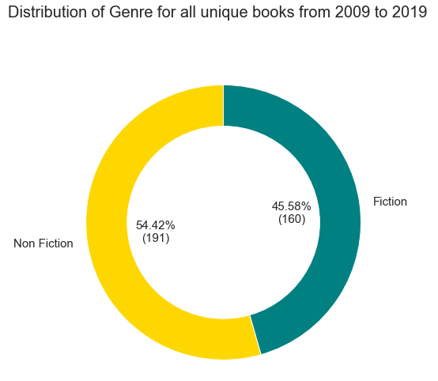
General distribution between books’ genre
Analyze this genre categorical distribution over the whole dataset for an overview
Of the 351 unique books, 54.4% were non-fiction and 45.6% were fiction.
6

Slide 7
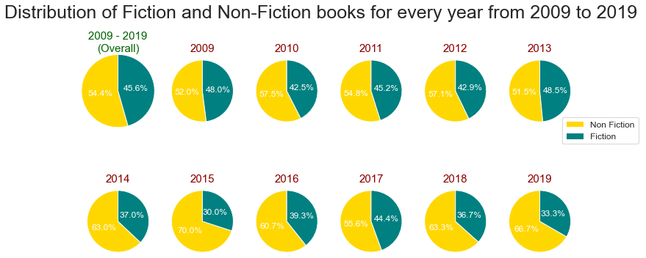
Analyzing the genre’s trend
According to the diagram, Non-Fiction was a more popular category than Fiction, each year from 2009 to 2019, and always account for more than half of the unique books categorized in the list.
The highest fraction (70%) of non-fiction books were sold in 2015 and the lowest for fiction books (30%). For fiction books, the highest fraction (48.5%) of books were sold in 2013. From the numbers, we can see that among the bestselling books, the division between these two genres fluctuates over year without any clear trend.
7

Slide 8


What is the interaction between number of reviews and unique books published to the author’s appearance on the list?

Slide 9
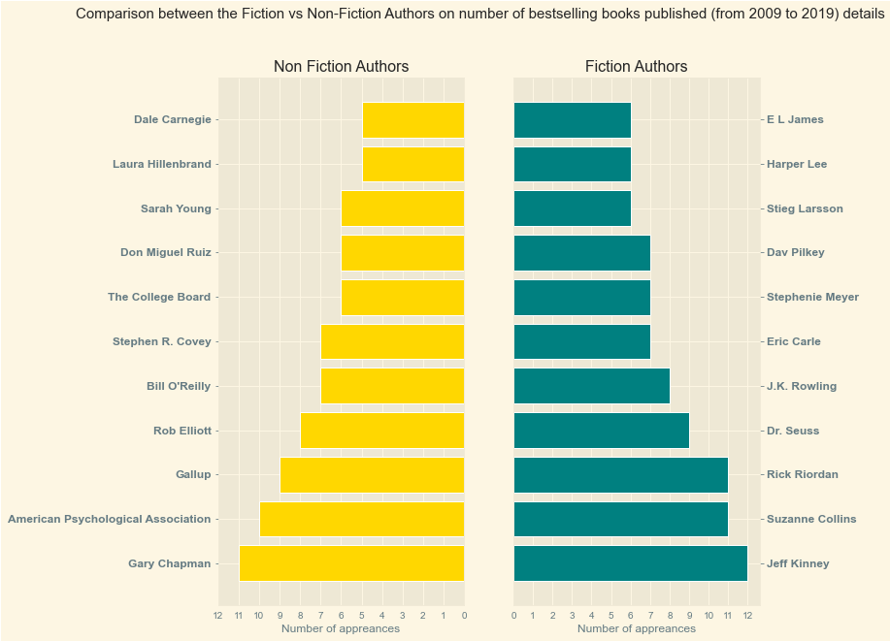
Top 10 bestselling authors between two genres
The bestselling authors are selected based on their appearances in the top 50 bestselling books each year, from 2009 to 2019. The number of appearances includes tittles that have stayed on the list for multiple years.
We can conclude that the number of author's appearance shares the same the structure between the two genre, with the distribution is slightly more skewed towards the top on the non-fiction genre.
This list contains many famous authors such as Dale Carnegie (Non-Fiction), J.K. Rowling (Fiction) as well as the APA.
Total number of appearances are higher on Fiction than Non-Fiction genre, throughout the distribution.
9

Slide 10
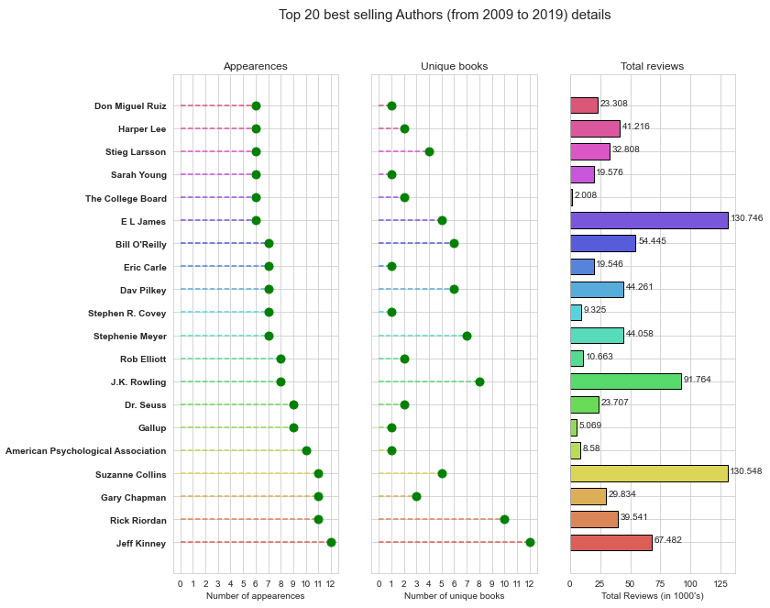
Author’s appearances, unique books and reviews
Author Jeff Kinney is the best-selling author with 12 appearances in best-selling books from 2009 to 2019.
We can see that there doesn't seem to have clear association between the total number of reviews to the author's number of appearances on this list; and likewise the relationship between number of unique books and reviews counts.
However, there is correlation between the number of unique books published and the number of author's appearances on this list, with a few exceptions of successful authors with books stay on the list for multiple years.
10

Slide 11

What is the User-Rating and Reviews interaction of books stay on the list for multiple of years?

Slide 12
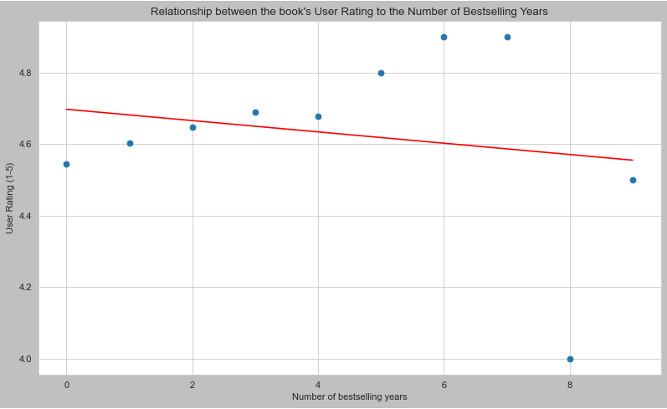
Book’s User Rating Versus the Number of Bestselling Years
With the above graph, the scatter plots shows a quite different story than the regression line, due to the 2 strong outliers on books which were on the list for 9 and 10 years.
In general, we can say that there is evidence from the plot to support the hypothesis if we disregard the abnormality of the outliers.
12

Slide 13
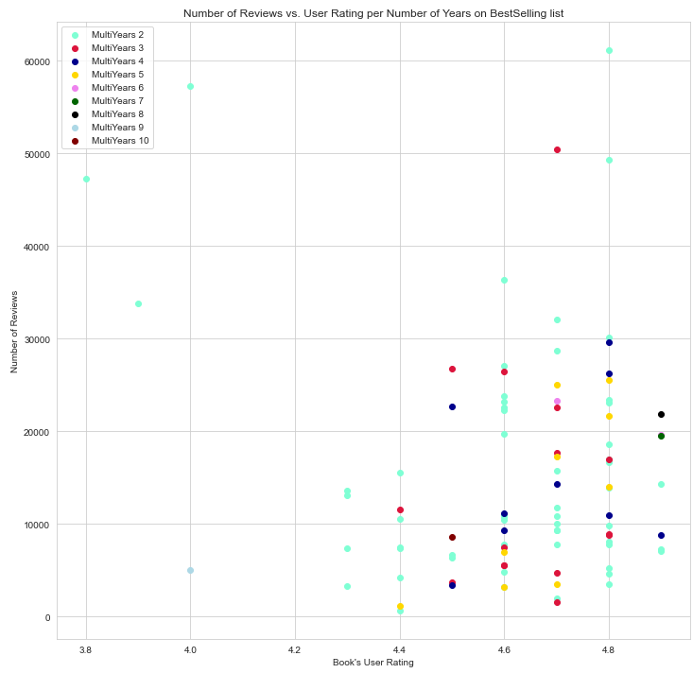
Demand Planning Process
With the above chart, it is apparent that user rating value of the books determines more on how successful it is on the market (simply based on how many bestselling years) with all above the 4.3 points.
The number of reviews doesn't make a clear cut hear since many books with the tops number of reviews but only stays on this list for 2 or 3 years; whereas most successful books stay between the range of 5-20000 reviews on the platform.
There seems to be also no general rules if the achievement on the combination of both of these measures will predict the book to be successful.
13

Slide 14
What are the conclusions?
Non-Fiction Books’ genre is the dominant category on this list
The number of author's appearance shares the same the structure between the two genre, with the distribution is slightly more skewed towards the top on the non-fiction genre. Total number of appearances are higher on Fiction than Non-Fiction genre, throughout the distribution.
There exists no clear association between the total number of reviews to the author's number of appearances on this list; and likewise the relationship between number of unique books and reviews counts.
However, there is correlation between the number of unique books published and the number of author's appearances on this list, with a few exceptions of successful authors with books stay on the list for multiple years.
There is evidence to support the hypothesis (the higher the book's user rating, the longer that particular book stays on the bestselling list), if we disregard the abnormality of the outliers.
It is apparent that user rating value of the books determines more on how successful it is on the market (simply based on how many bestselling years) with all above the 4.3 points, the higher the longer the book will stay.
The number of reviews doesn't make a clear cut hear since many books with the tops number of reviews but only stays on this list for 2 or 3 years; whereas most successful books stay between the range of 5-20000 reviews on the platform.
There seems to be also no general rules if the achievement on the combination of both of these measures will predict the book to be successful.

Slide 15
Thank you for your attention!
Have a nice day and success

